Slide 1
PAP-Predict
Using AI to Identify Cervical Cancer

Slide 2
Why Cervical Cancer?
Leading cause of Cancer deaths in developing world.
3rd most common Cancer in Women.
Early Detection increases survival rate.

Slide 3
275,000
Women Die Of Cervical Cancer Each Year

Slide 4
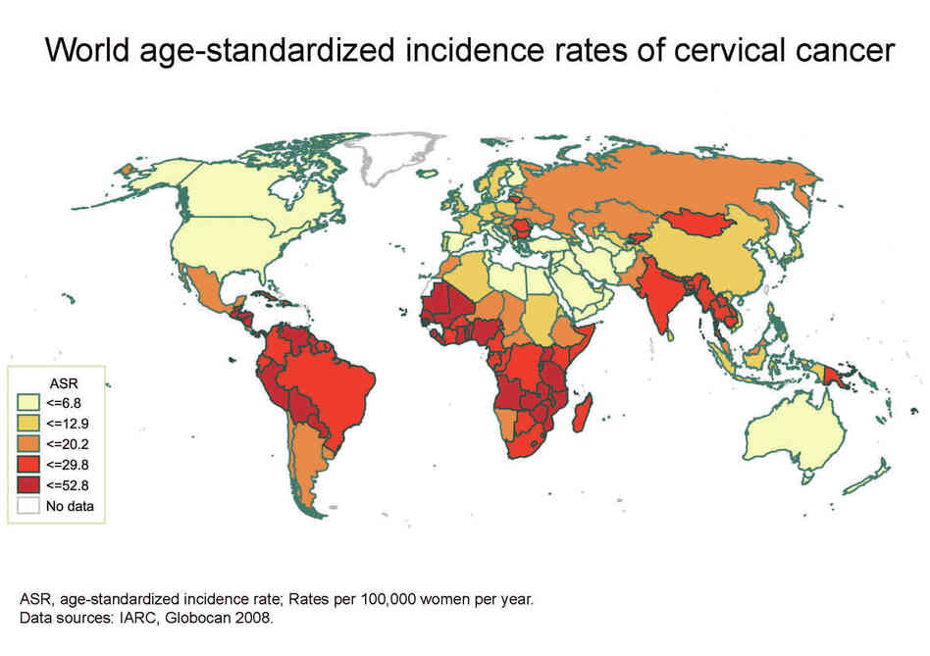
Cervical Cancer Globally (NPR)

Slide 5
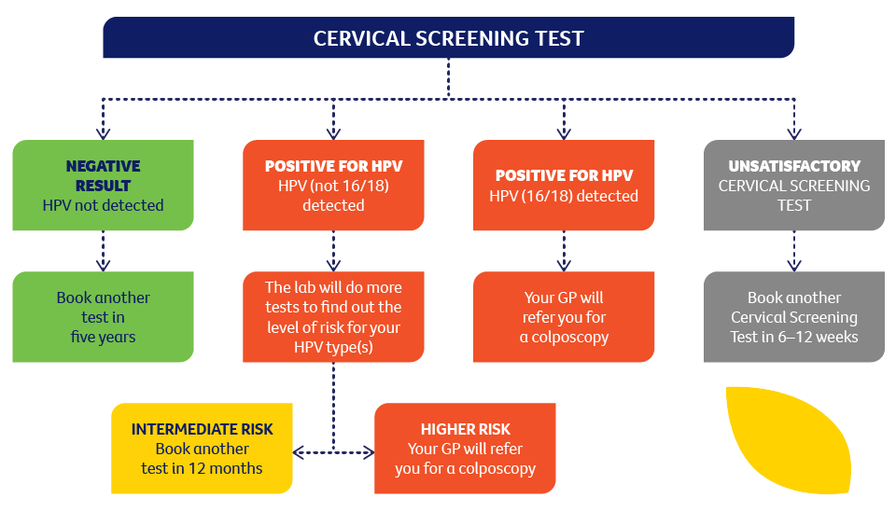
Current Cervical Cancer Testing Process

Slide 6
GOAL
Increase Detection
Lower Cost

Slide 7
1.
CERVICAL CANCER RISK DATASET
OVERVIEW
858 Patients
Factors leading to Cervical Cancer
36 Attributes
1.

Slide 8
Screening Tests
2.
Hinselmann
Schiller
Cytology
Biopsy

Slide 9
Medical History
HPV
STDs/STIs
Biopsy results
Number of Pregnancies
3.

Slide 10
4.
Behavioral Factors
Smoking
Contraceptive Use
Number of Sexual Partners
Smoking
Contraceptive Use
Number of Sexual Partners

Slide 11
Deep Learning Model Architecture
🧩 Architecture:
Input Layer: 62 features
Hidden Layer 1: 10 neurons, ReLU activation
Hidden Layer 2: 8 neurons, ReLU activation
Output Layer: 2 neurons, Softmax (binary classification: Biopsy / No Biopsy)
🛠 Tools Used:
TensorFlow, Keras, scikit-learn, pandas
🧠 Model Type:
Sequential Neural Network (Keras) Designed to learn complex, nonlinear relationships between health risk factors and biopsy outcomes.
📊 Input:
Numerical & categorical risk factors (e.g., HPV presence, smoking history, STDs, contraceptive use) Preprocessed via standard scaling and one-hot encoding.
Smoking
Contraceptive Use
Number of Sexual Partners

Slide 12
Model Performance & Evaluation
📊 Evaluation Metrics:
Accuracy: ~95% (on test set)
ROC AUC: ~0.86 (Robust classification performance)
Validation Loss & Accuracy Curves: (Training vs validation plot attached)
🔍 Confusion Matrix Insight:
Shows balance in true positives and true negatives
Useful for understanding risk of false negatives (missed cases)
📌 Key Takeaways:
The model learns meaningful patterns in clinical risk data
Generalizes well to unseen data
Can be integrated into healthcare workflows to support decision-making
Smoking
Contraceptive Use
Number of Sexual Partners

Slide 13
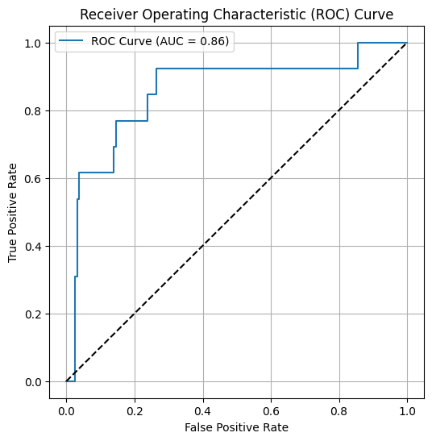
Contents of this template

Slide 14
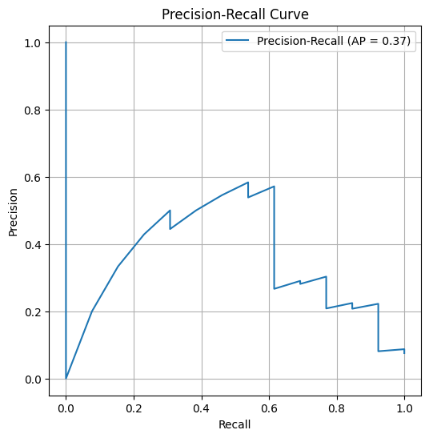
“This is a quote. Words full of wisdom that someone important said and can make the reader get inspired.”
—Someone famous

Slide 15
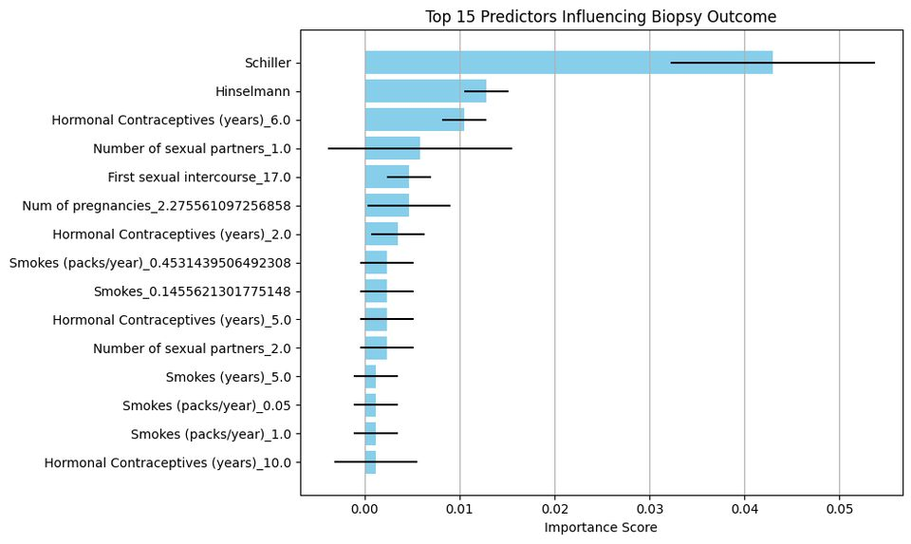
Introduction
Mercury is the closest planet to the Sun and the smallest one in the Solar System—it’s only a bit larger than the Moon. The planet’s name has nothing to do with the liquid metal since it was named after the Roman messenger god

Slide 16
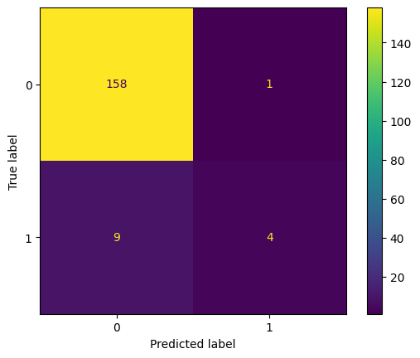

Key numbers
50,ooo
20,000
5,000
Neptune is the farthest planet from the Sun
Venus has a beautiful name, but it’s hot
Mercury is the closest planet to the Sun

Slide 17
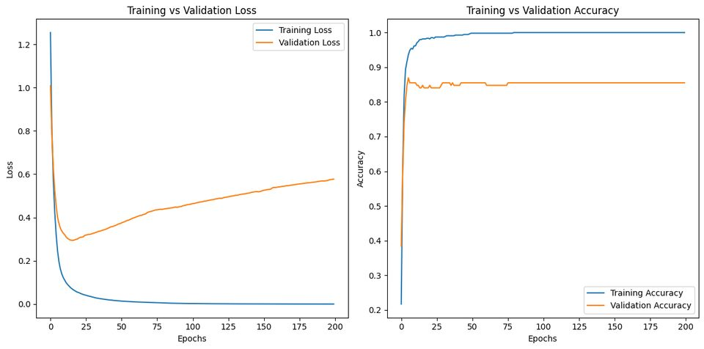
DIAGNOSIS
Mercury
Saturn
Mercury is the closest planet to the Sun and the smallest of them all
Saturn is the ringed planet. It’s composed mostly of hydrogen and helium

Slide 18
Envisioning Future AI usage through Cervical cancer
Effective Prevention of Cervical Cancer.
Fast and low cost Treatment options globally.

Slide 19

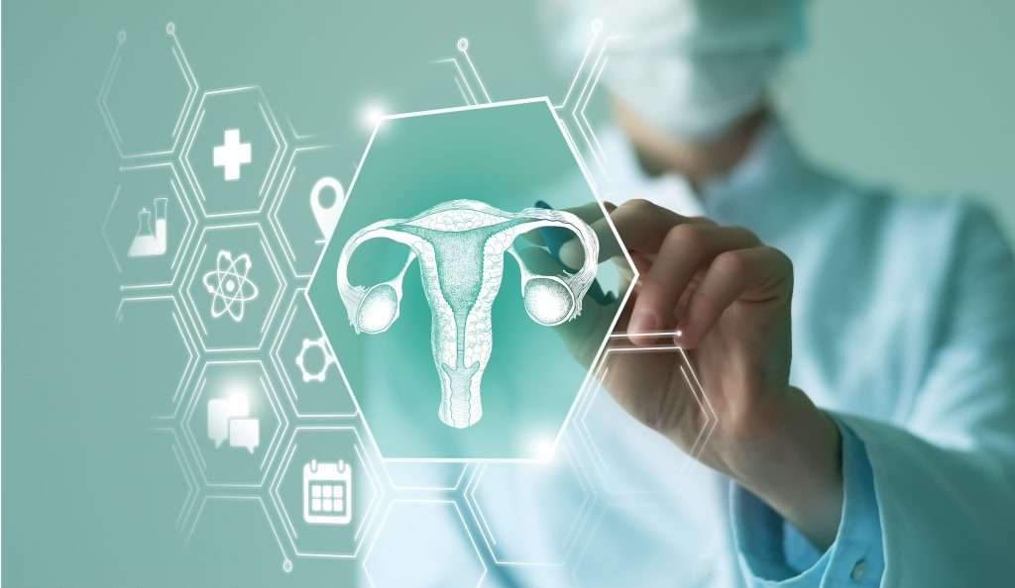
Ethical Concerns
Bias in model
Sensitive Data

Slide 20
Conclusion
Our model successfully predicts cervical cancer risk. When combined with the application’s interactive visualizations, it allows users to explore patterns in the data, interpret model outputs more clearly, and gain deeper insights into key risk factors. Together, they create a powerful tool for informed decision-making and early intervention.

Slide 21
Objective
Our objective is to develop a predictive model using the Cervical Cancer Risk Factors dataset to accurately determine the likelihood of an individual having cervical cancer based on various behavioral, medical, and lifestyle risk indicators. By leveraging machine learning techniques, we aim to identify key predictors of cervical cancer and build a model that can support early detection and targeted intervention efforts.

Slide 22
WHY Cervical Cancer?
Leading Cause of Cancer Deaths in the Developing World
3rd Most Common Cancer in Women
275,000 Deaths per Year
One of the Most Preventable and Treatable Cancers
Early Detection Increases Survival Rate to Over 90%

Slide 23
Sources:
Risk Factors for Cervical Cancer - Dataset Repository
Data Science Dojo / Github Repository
Cervical Cancer Screening: Past, Present, and Future
ScienceDirect
Price Break for Cervical Cancer Shots in Developing World
NPR - Health News: Shots
Self-Collection of Vaginal Samples for HPV Testing
BD Women’s Health

Slide 24

Team 9
Max Pietrykowski (mrpietrykowski@wm.edu)
Parth Parker (psparker@wm.edu)
Stefan Ngoh (sengoh@wm.edu)
Lucas Carmichael (lacarmichael@wm.edu)

